Slide 1

8th Grade Math: Pre-Algebra
Unit 10, Lesson 9 Is It Linear? Volume 2, pg. 163

Slide 2


Benchmarks
MA.8.F.1.1
Given a set of ordered pairs, a table, a graph, or mapping diagram, determine whether the relationship is a function. Identify the domain and range of the relation.
MA.8.F.1.2
Given a function defined by a graph or an equation, determine whether the function is a linear function. Given an input-output table, determine whether it could represent a linear function.
volume 2, pg. 163

Slide 3
Integrated Mathematical Thinking and Reasoning Standards
MA.K12.MTR.1.1 Actively participate in effortful learning both individually and collectively.
MA.K12.MTR.2.1 Demonstrate understanding by representing problems in multiple ways.
MA.K12.MTR.4.1 Engage in discussions that reflect on the mathematical thinking of self and others.
MA.K12.MTR.5.1 Use patterns and structure to help understand and connect mathematical concepts.
volume 2, pg. 163

Slide 4

Learning Targets
I can determine whether a function is a linear function given an equation or graph.
I can determine whether a relation is a function.
volume 2, pg. 163

Slide 5

Warm-Up
volume 2, pg. 164

Slide 6
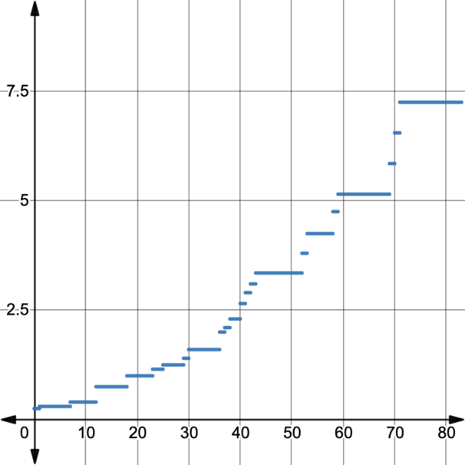
10.9.1 Warm-Up: Notice and Wonder
The graph shows how the value of the U.S. federal hourly minimum wage changed from 1938-2020.
What do you notice?
What do you wonder?
U.S. Federal Minimum Wage per Hour
Number of Years Since 1938
volume 2, pg. 164

Slide 7

Collaboration
volume 2, pg. 164

Slide 8

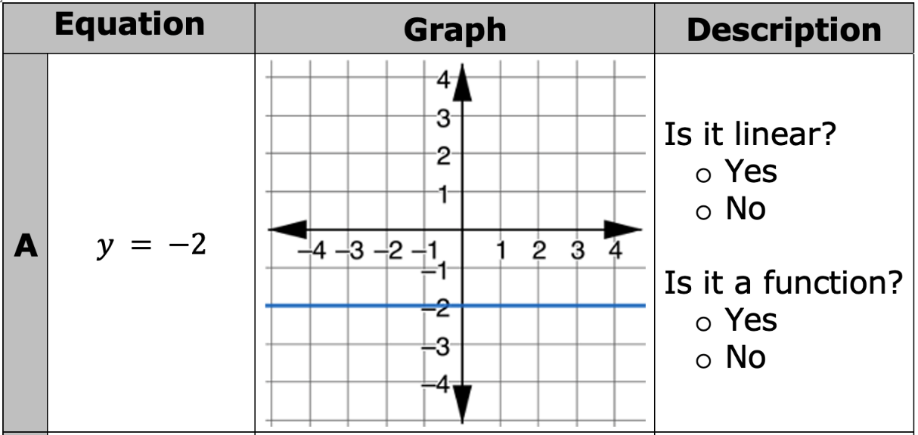
10.9.2 Collaboration: Revising Conjectures About Non-Linear Equations
Work with your partner to answer the questions for the description of each equation and its graph.
volume 2, pg. 164

Slide 9
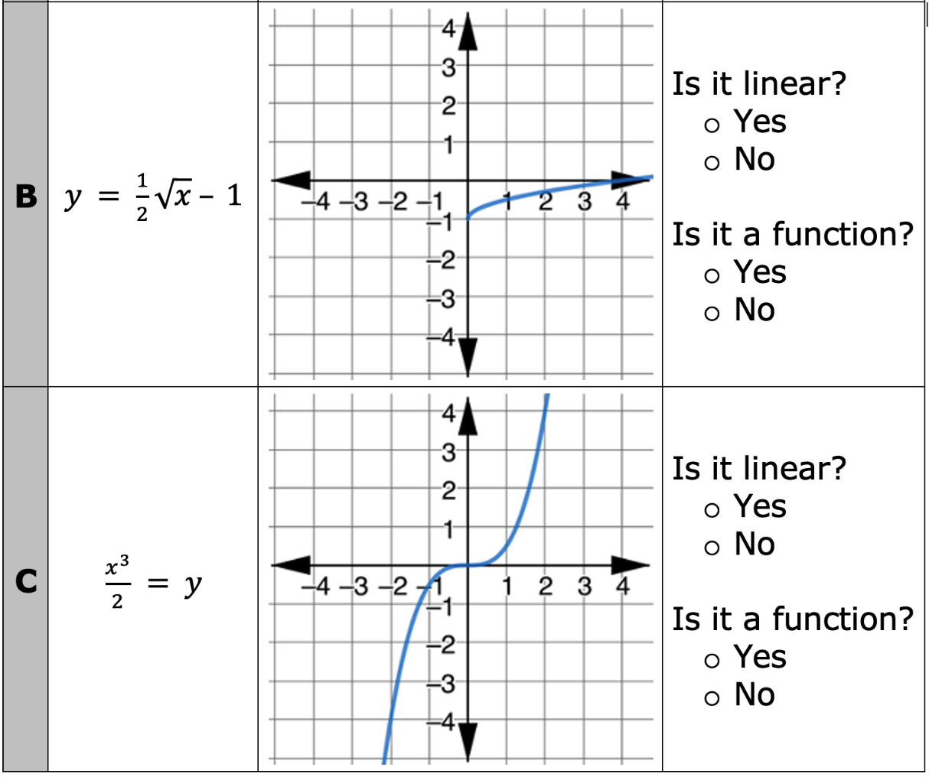
volume 2, pg. 164

Slide 10
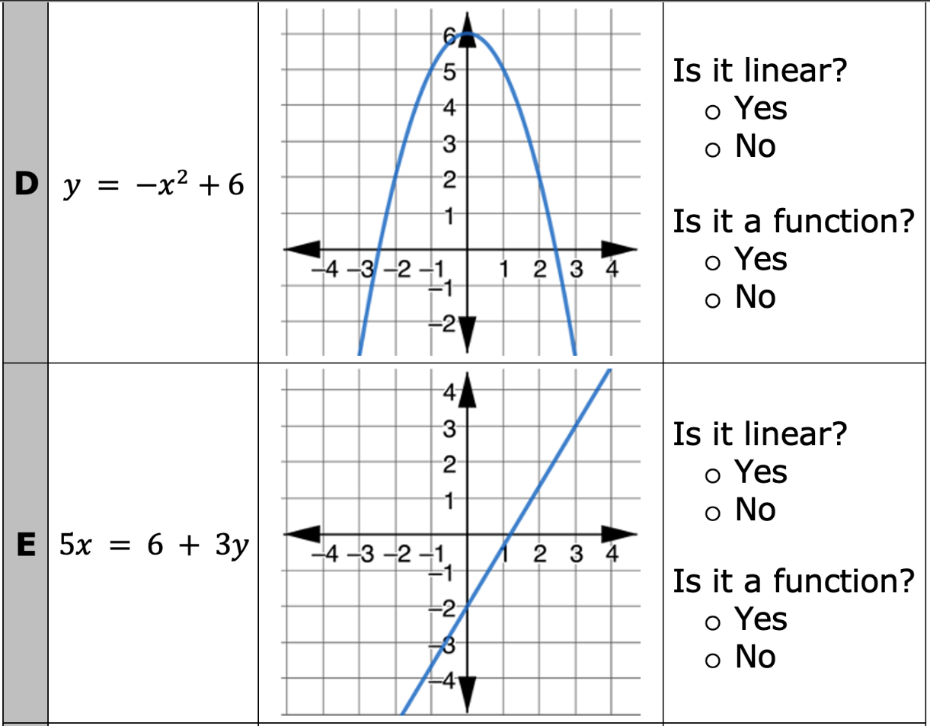
volume 2, pg. 165

Slide 11
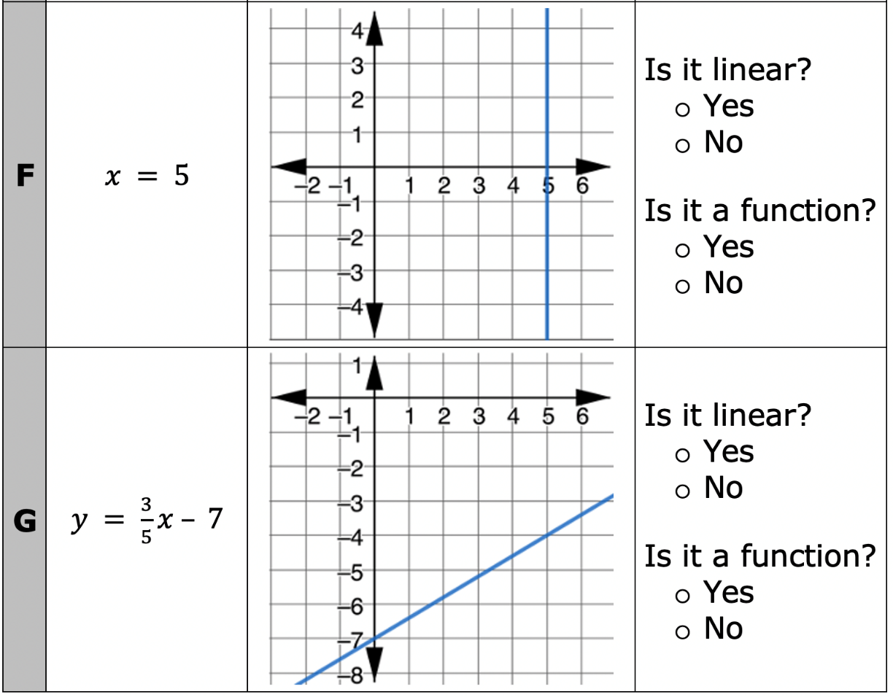
volume 2, pg. 165

Slide 12
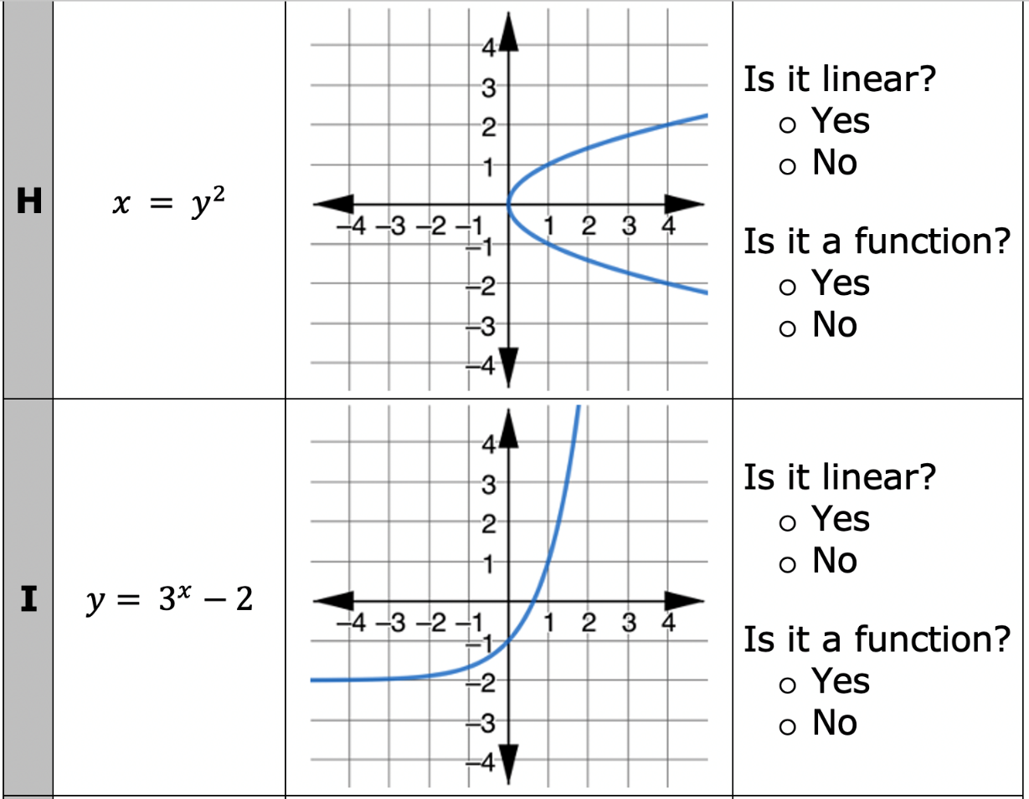
volume 2, pg. 165

Slide 13
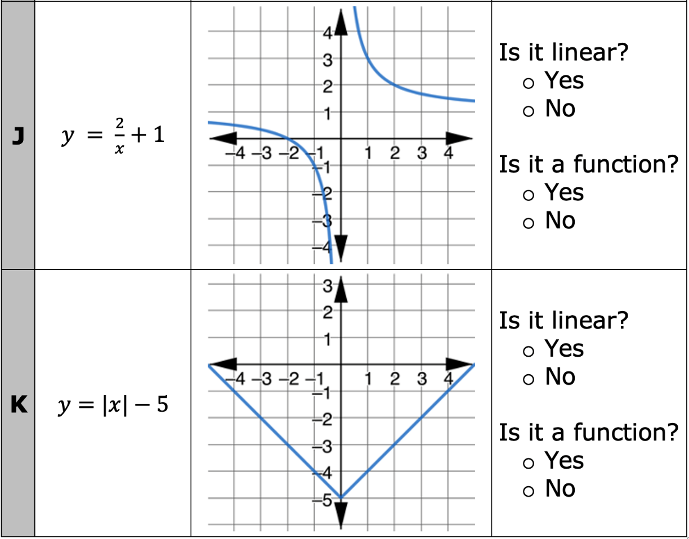
volume 2, pg. 165

Slide 14
Work with your partner to answer the following questions based on your observations of the relations in the table.
Which equations are not functions? Write the equations.
Explain how to use the graph of an equation to determine if the equation represents a function.
volume 2, pg. 166

Slide 15
What do you notice about the variables 𝑥 and 𝑦 in the equations that are linear?
Write at least one phrase that could be used to complete the statement below.
An equation is not linear if either variable is …
volume 2, pg. 166

Slide 16
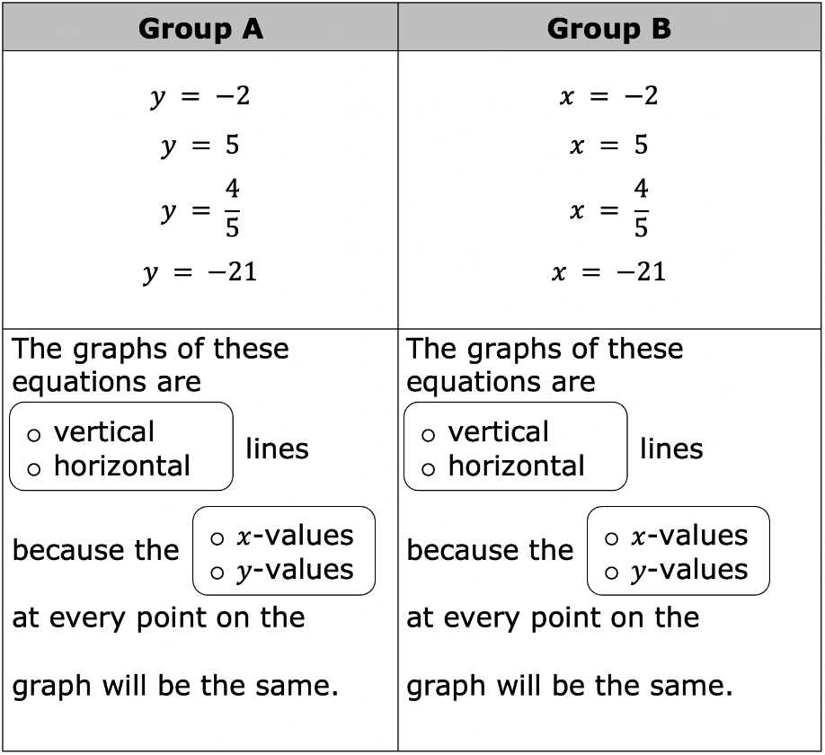
The equations of several relations are organized in the table. Complete the statement to describe the graphs of these equations.
volume 2, pg. 166

Slide 17
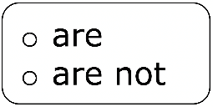
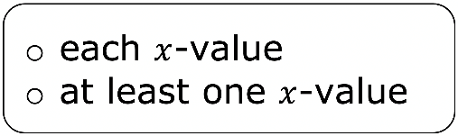
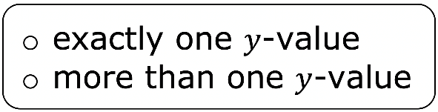
Complete the statement.
The equations in Group B functions because corresponds to on the graph.
volume 2, pg. 166

Slide 18

Bring It Together
volume 2, pg. 167

Slide 19
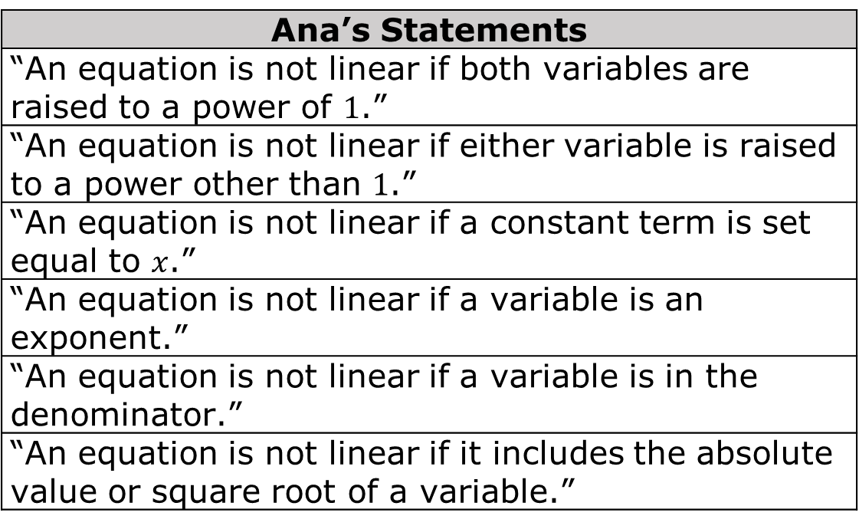
10.9.3 Bring It Together: Revising Conjectures About Non-Linear Equations
Ana made several statements after completing the collaboration with her partner. Some of her statements are not true. Cross out any false statements.
Ana’s Statements
“An equation is not linear if both variables are raised to a power of $1$.”
“An equation is not linear if either variable is raised to a power other than $1$.”
“An equation is not linear if a constant term is set equal to $x$.”
“An equation is not linear if a variable is an exponent.”
“An equation is not linear if a variable is in the denominator.”
“An equation is not linear if it includes the absolute value or square root of a variable.”
volume 2, pg. 167

Slide 20
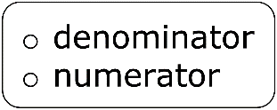
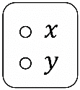
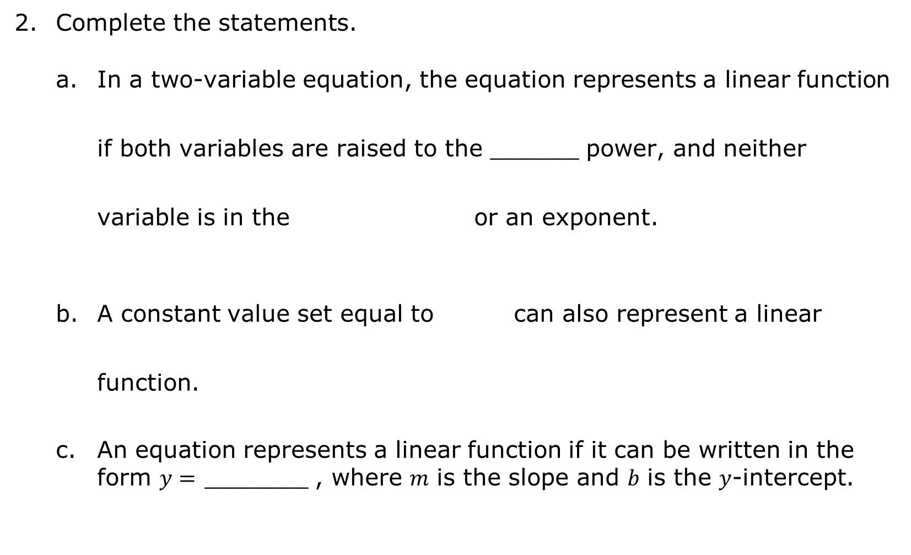
Complete the statements.
In a two-variable equation, the equation represents a linear function if both variables are raised to the ______ power, and neither variable is in the or an exponent.
A constant value set equal to can also represent a linear function.
An equation represents a linear function if it can be written in the form $y=$ _______ , where 𝑚 is the slope and 𝑏 is the 𝑦-intercept.
volume 2, pg. 167

Slide 21

Your Turn
volume 2, pg. 167

Slide 22
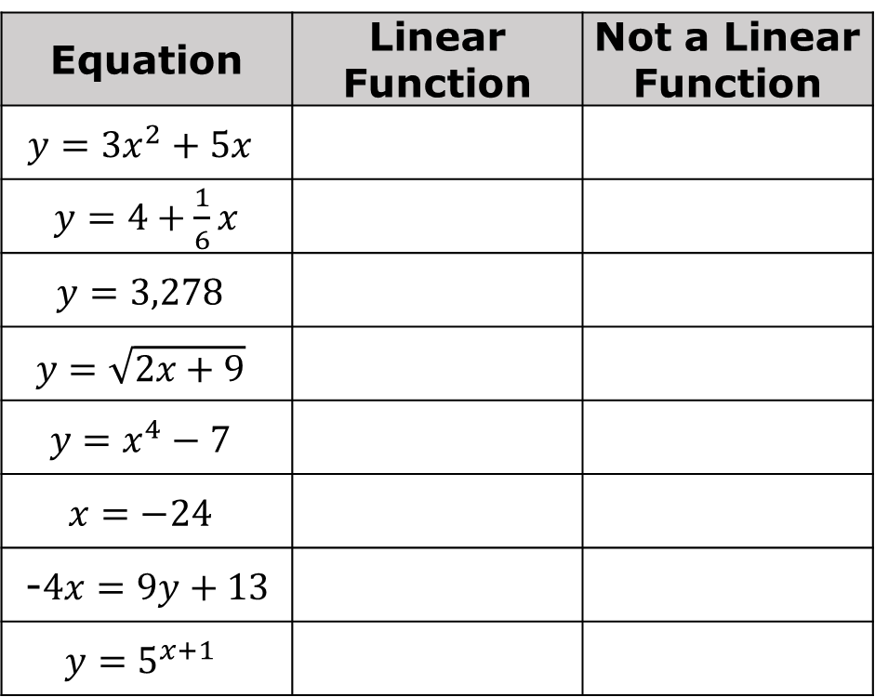
10.9.4 Your Turn!
Complete the table.
Equation | Linear Function | Not a Linear Function
$$y=3x^{2}+5x$$
$y=4+\frac{1}{6}x$
$$y=3,278$$
$$y=\sqrt{2x+9}$$
$$y=x^{4}−7$$
$$x=−24$$
-$4x=9y+13$
$$y=5^{x+1}$$
volume 2, pg. 167

Slide 23
Choose one equation from the table and explain why it is not a linear function.
Choose one equation from the table and explain why it is a linear function.
volume 2, pg. 167

Slide 24

Wrap-Up
volume 2, pg. 168

Slide 25
10.9.5 Wrap-Up: Reflection
Complete each statement as you reflect on today’s learning.
When someone asks me what I did in math today, I can say …
The thing that made the most sense to me today was …
Something that I still do not understand is …
volume 2, pg. 168

